Slide 1
FACE RECOGNITION USING CNN
INTRUSION DETECTION SYSTEM

Slide 2
INTRODUCTION
Face recognition has been an integral part of today's security technology.
- Our project is a signature-based intrusion detection system.
- Facial recognition, in our project is achieved using Convolutional neural network .
- The project is built using “dlib”, state-of-the-art face recognition library in Python.

Slide 3
CHALLENGES
1) CNN does not encode the position and orientation of the object.
2) Inefficiency to be spatially invariant to images.
3) The exploitation of colors and degradation in performance.
4) Poor predictions when it comes to detecting identical twins.
5) Ageing poses a challenge as face appearance/texture changes over a period.

Slide 4
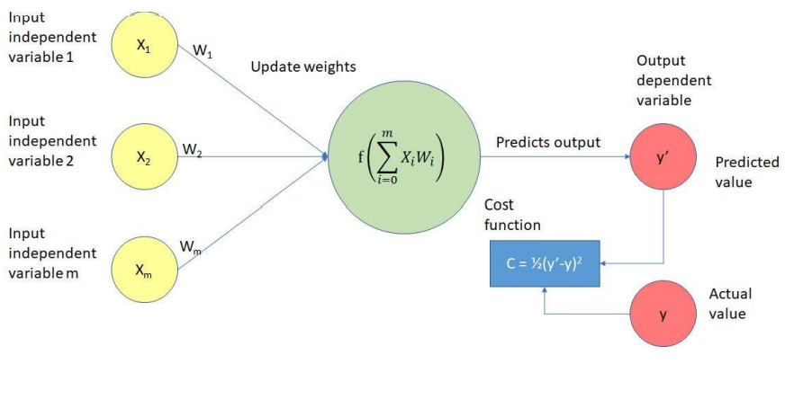
METHODOLOGY
How do neural networks learn?

Slide 5
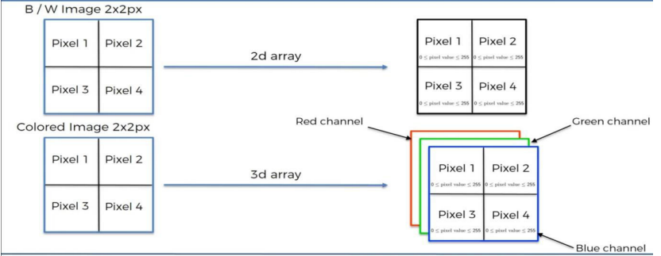
CONVOLUTIONAL NEURAL NETWORK

Slide 6
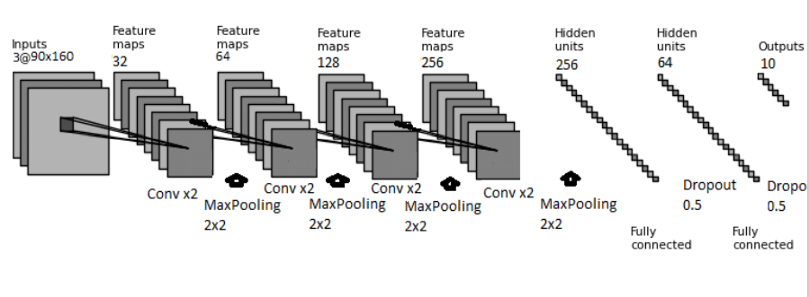
STEPS INVOLVED

Slide 7
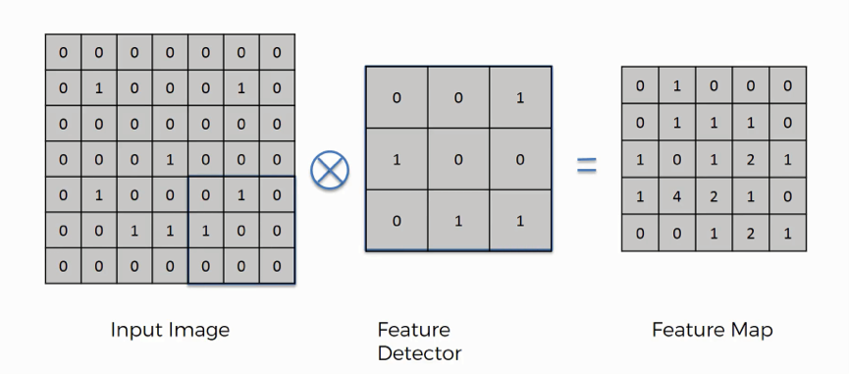
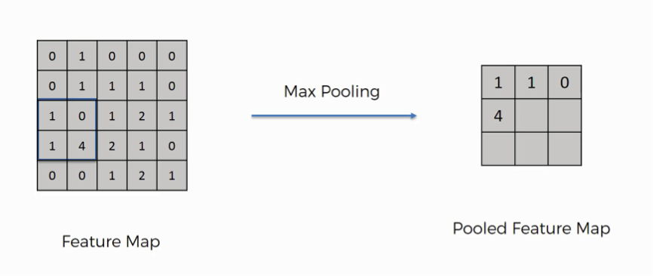
Steps involved in processing of image

Slide 8
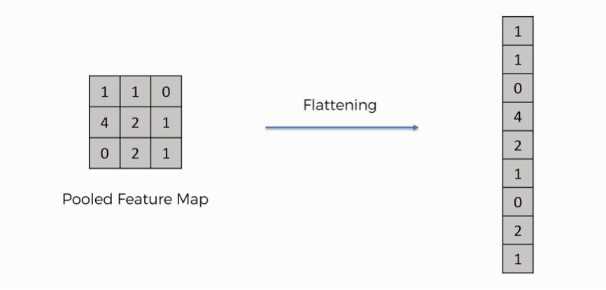
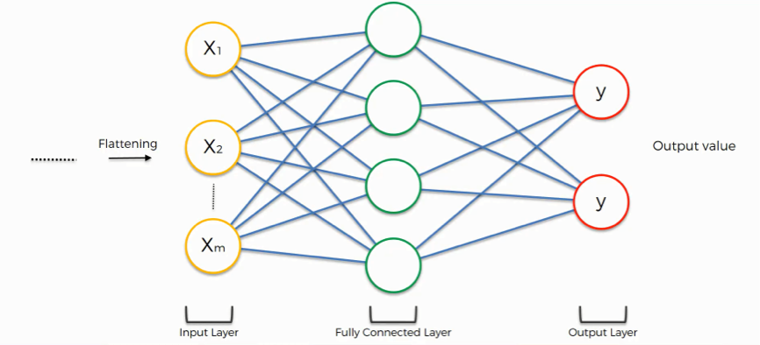

Slide 9



IMPLEMENTATION
AFTER
ADDING USER TO DATABASE

Slide 10
RESULT AND CONCLUSION
The application is able to differentiate between an intruder and an authorized user very conveniently.
The model has an accuracy of 99.38% on the Labeled Faces in the Wild benchmark.
The face detection is performed on live acquired images without any application field in mind.
The system is able to recognize and identify any person and give prompt alerts if the face is not recognised.
System is also capable of detecting and recognizing multiple faces in live acquired images.

Slide 11
THANK
YOU

